Slide 1









Pharmacy Management System
Presented To:
Dristi Saha
Lecturer
Department Of CSE,
Daffodil International University
Presented By:
Nurjahan Akther Mim 221-15-4782
Abu Zahed 221-15-4716
Md Amir Hamja 221-15-4784
Arnub Datta 221-15-4726
Section: 61_L Department Of CSE

Slide 2





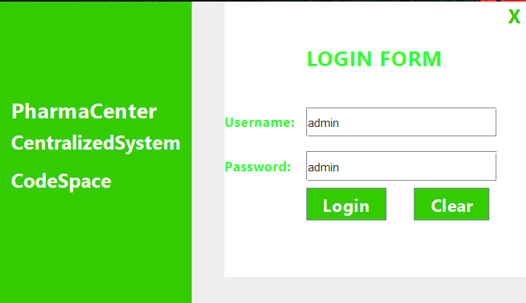


LogIn
Our Vision
String query = "select * from user1.agents where name = '" + tbUserId.getText() + "' and password = '" + tbPassword.getText() + "'";

Slide 3
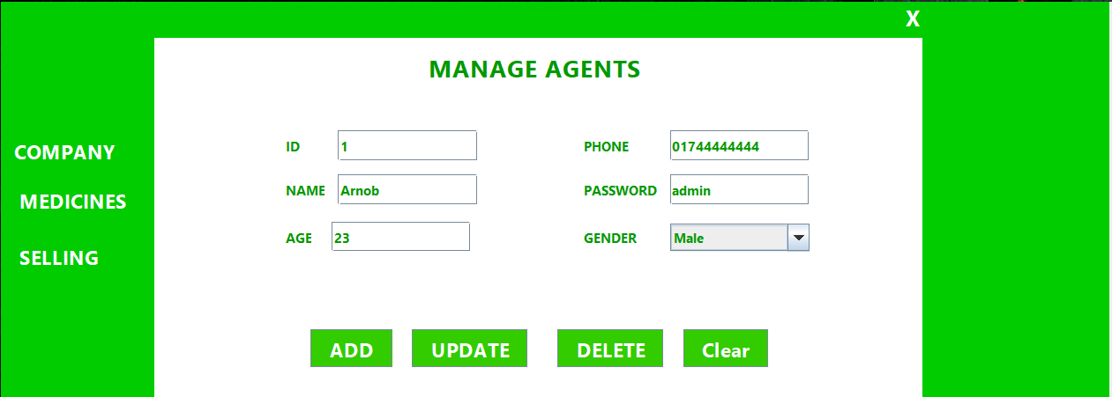
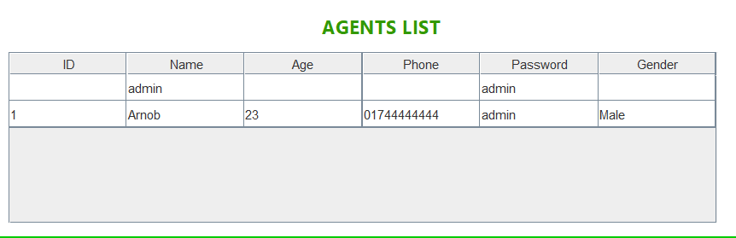
Agents Form
PreparedStatement ps = conn.prepareStatement("insert into agents values(?,?,?,?,?,?)");

Slide 4
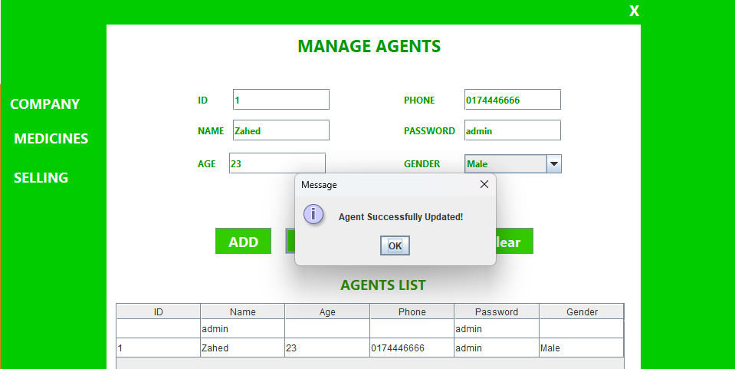
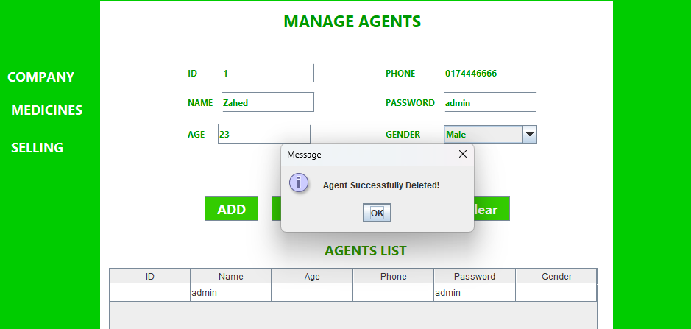
Agents Form
Update:
PreparedStatement ps = conn.prepareStatement("update agents set name=?, age=?, phone=?, password=?, gender=? where id=?");
Delete:
String query = "Delete from user1.agents where id = " + id;

Slide 5
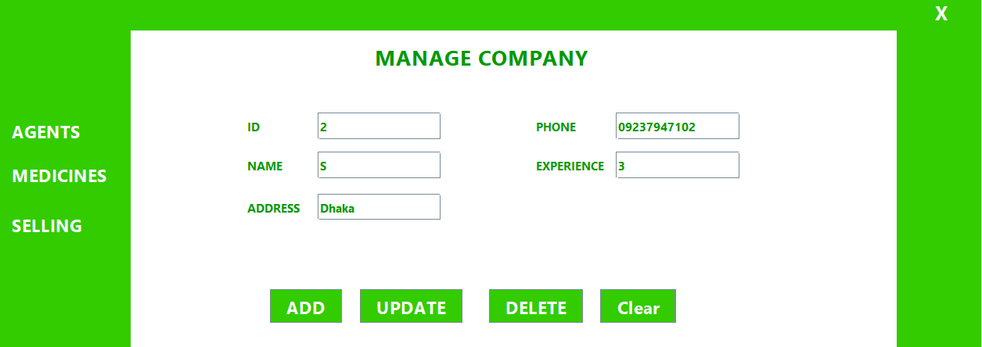
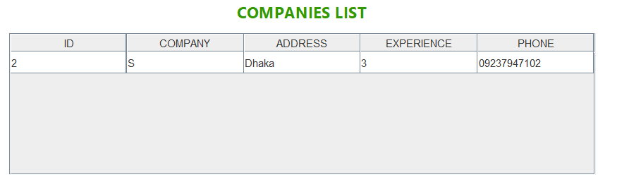
Company Manage Form
Our Vision
PreparedStatement ps = conn.prepareStatement("insert into companies values(?,?,?,?,?)");

Slide 6
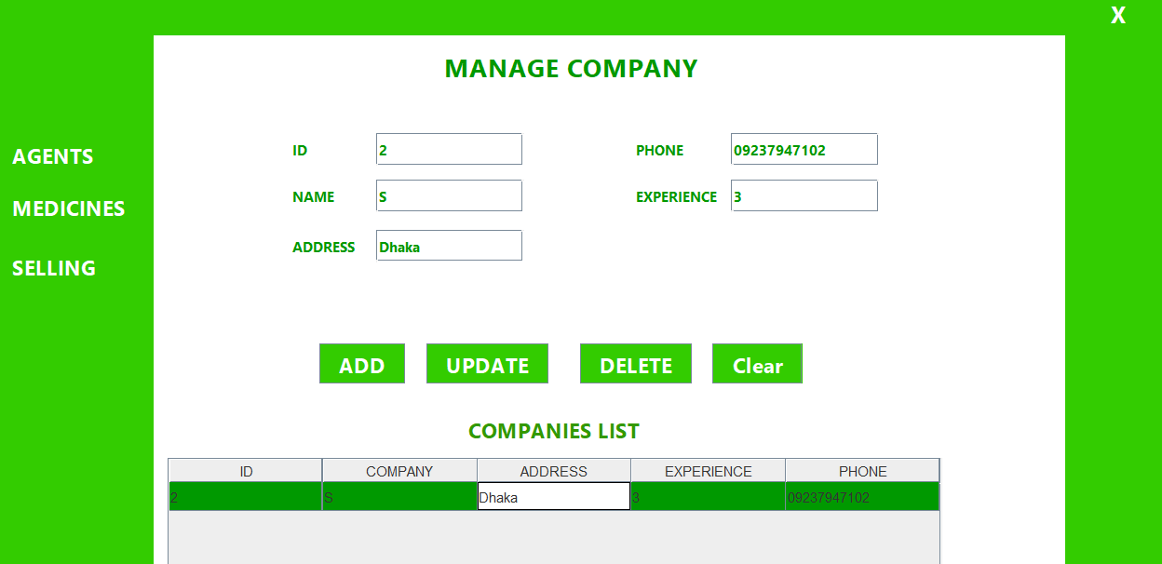
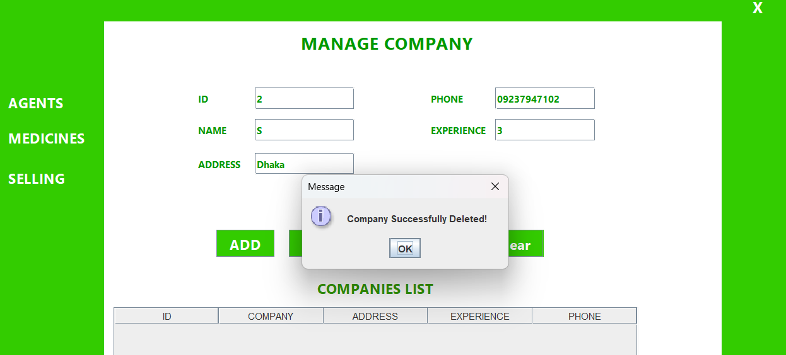
Company Manage Form
Our Vision
Update:
PreparedStatement ps = conn.prepareStatement("update companies set name=?, address=?, companyExp=?, phone=? where id=?");
Delete:
String query = "Delete from user1.companies where id = " + id;

Slide 7
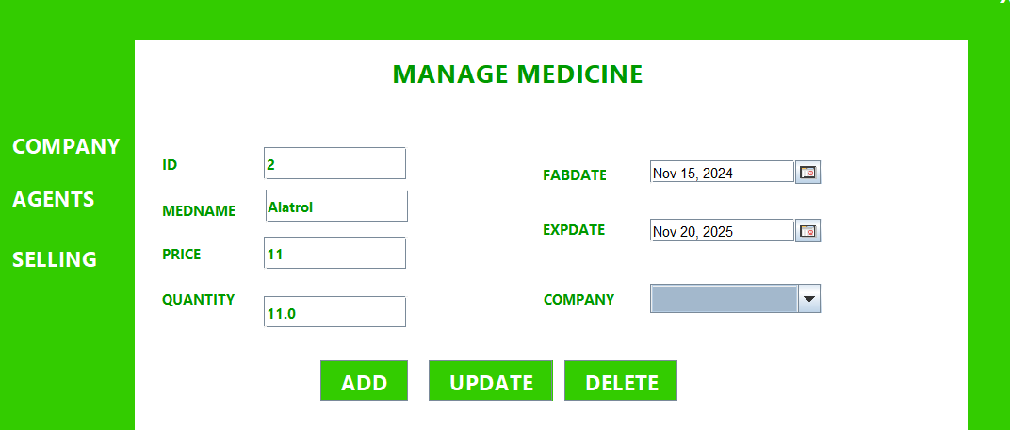
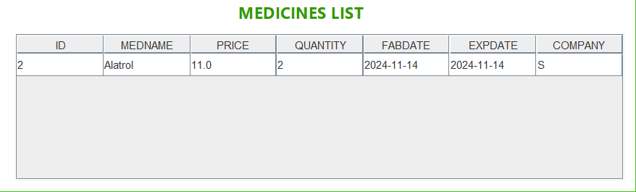
Medicine Manage Form
Medicine ADD:
PreparedStatement ps = conn.prepareStatement("insert into medicines values(?,?,?,?,?,?,?)");

Slide 8
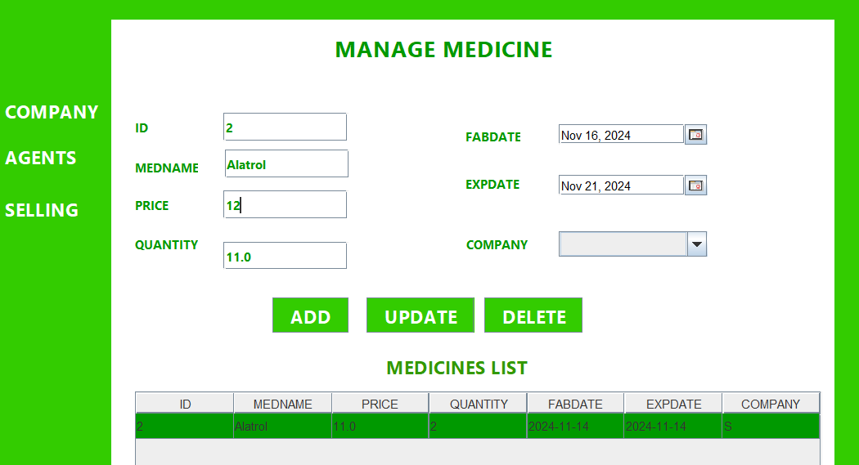
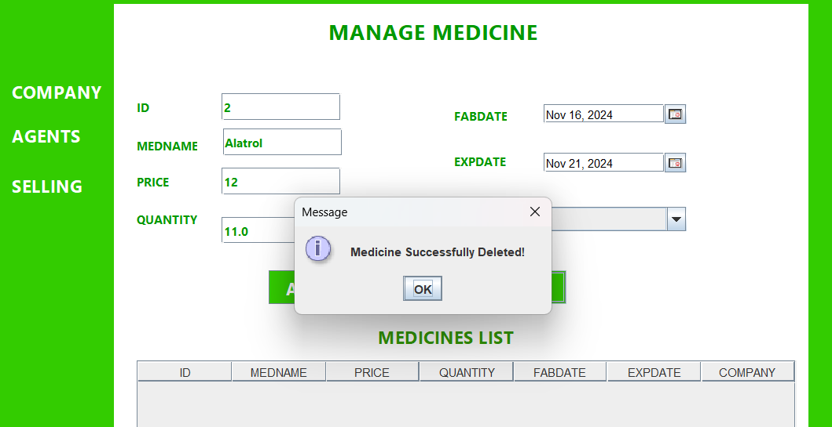
Medicine Manage Form
Our Vision
Update:
String queryUpdate = "Update user1.medicines set medname = '" + tbMedName.getText() + "'" + ",price = " + tbMedPrice.getText() + "" + ",quantity = " + tbMedQty.getText() + "" + ",fabdate = '" + myFabDate + "'" + ",expdate = '" + myExpDate + "'" + ",medcomp = '" + ddlCompany.getSelectedItem().toString() + "'" + "where id = " + id;
Delete:
String query = "Delete from user1.medicines where id = " + id;

Slide 9
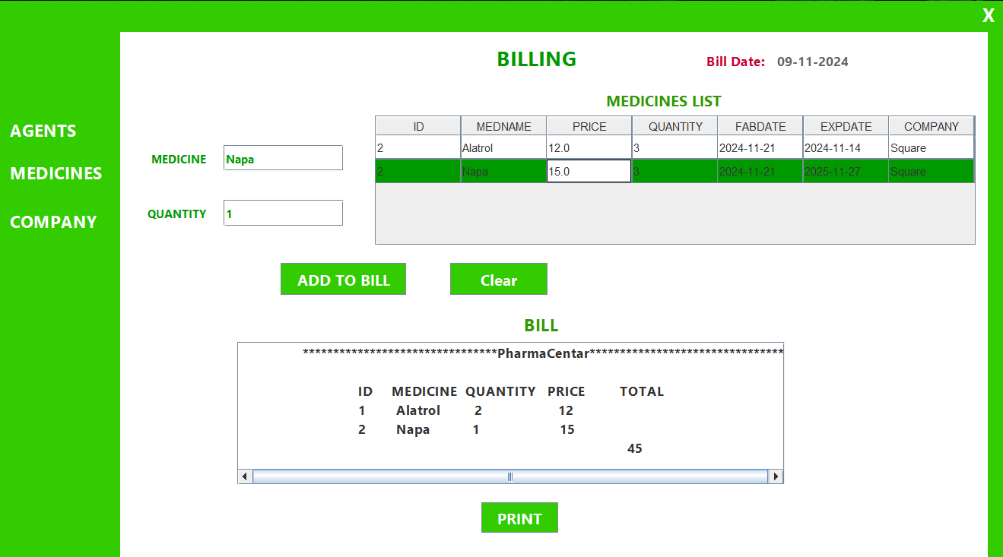
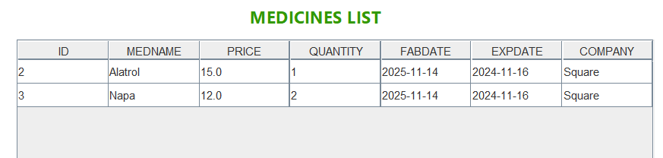
Billing Form
After Selling Update Medicine List:
String queryUpdate = "Update user1.medicines set quantity = " + newQty + "" + "where id = " + medId;

Slide 10


THANK YOU!😀

